Slide 1

Smart IoT Weather Monitoring Station
Presenters
23-NTU-CS-1080 M Zohaib Warraich
23-NTU-CS-1067 Hanzala zahid
23-NTU-CS-1054]. M Umair

Slide 2


Introduction
Overview: A compact, internet-connected station that monitors local weather conditions.
Goal: To provide accurate, real-time environmental data (Temperature, Humidity, Rain, Air Quality) accessible from anywhere via smartphone.
Core Tech: Built on the ESP32 microcontroller using Blynk IoT.

Slide 3
Problem Statement
Existing weather apps give general city-wide data, not hyper-local conditions (e.g., your specific garden or farm).
Need for an affordable, localized system to detect sudden changes like rain or gas leaks.
Importance of tracking 'Feels Like' temperature (Heat Index) for health safety.

Slide 4
Hardware Components
Microcontroller: ESP32 (Dual-core, built-in WiFi/Bluetooth).
Sensors:
- DHT11: Temperature & Humidity.
- BMP280: Barometric Pressure (Crucial for prediction).
- Rain Sensor: Detects precipitation immediately.
- MQ-5: Air Quality/Gas Sensor (LPG, Smoke).

Slide 5
System Architecture
IoT Connectivity: Connects to WiFi to send data to the Blynk Cloud.
Real-time Dashboard: Mobile app visualizes live data with gauges and graphs.
Local Interface: OLED screen automatically cycles through 3 information screens (Weather, Sensors, Forecast).
Smart Alerts: Send email notifications via Gmail SMTP for critical events (e.g., 'High Temp Alert', 'Rain Detected').

Slide 6
Advanced Algorithms (The 'Smart' Part)
Weather Prediction: Analyzes pressure trends over time (10-minute intervals).
- Rising Pressure → Sunny/Clearing
- Falling Pressure → Storm/Rain Likely
Heat Index Calculation: Calculates the 'Real Feel' temperature based on humidity logic.
Air Quality Status: Converts raw sensor data into human-readable text (Safe / Warning / Danger).

Slide 7
Working Principle
Sense: Sensors collect analog and digital environmental data.
Process: ESP32 filters noise, calculates Heat Index, and runs prediction logic.
Transmit: Data is pushed to the Blynk Cloud via WiFi.
Notify: If thresholds are breached (e.g., Temp > 40°C or Gas detected), the system triggers an emergency Email alert.

Slide 8
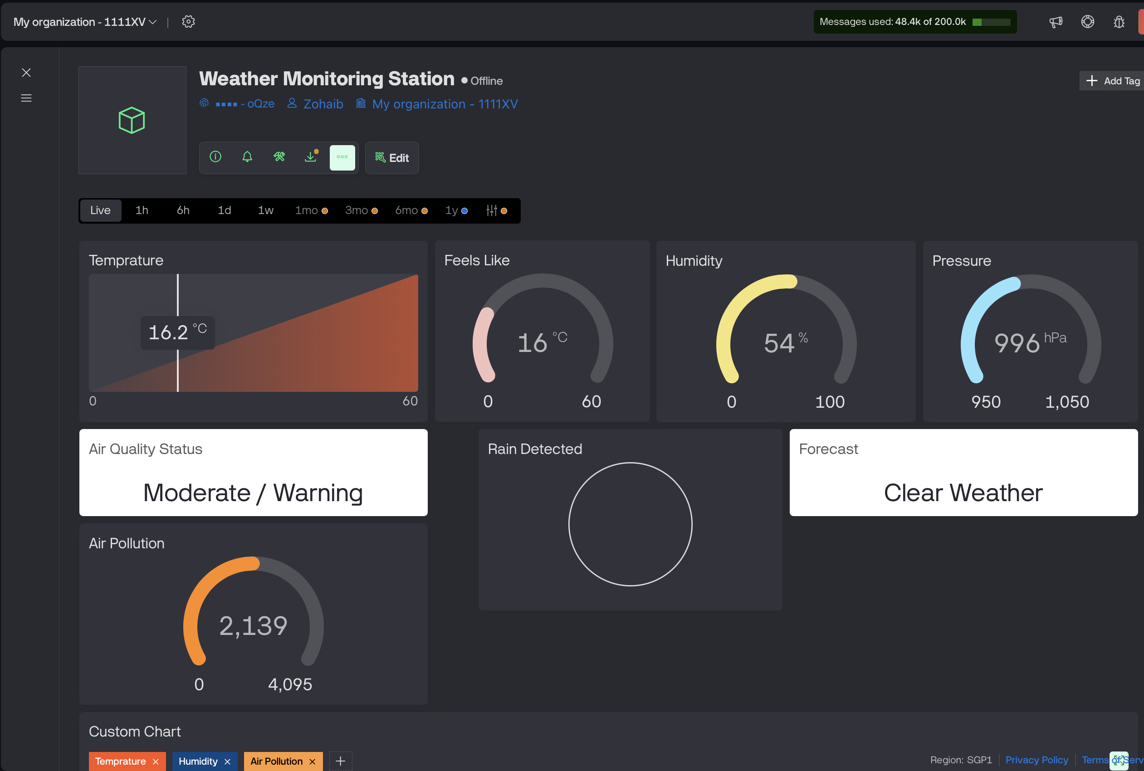
Results & Dashboard
Key Highlight: Show the Sensors Statuses, text widgets and Weather Prediction string.

Slide 9
Advantages
Hyper-local Accuracy: Measures conditions exactly where it is placed.
Cost-Effective: Uses standard, affordable components.
Low Maintenance: Automatic reconnection to WiFi and long-term stability.
Safety: Detects hazardous gas levels (MQ-5) and warns immediately.

Slide 10
Future Scope
Integration with Solar Power for off-grid usage.
Adding Anemometer (Wind Speed) and Wind Vane (Direction).
Machine Learning for better long-term weather prediction.

Slide 11
Conclusion
The project successfully demonstrates how IoT can be used for personal safety and environmental awareness.
It combines hardware sensing with software intelligence for a complete monitoring solution.

Slide 12
Thank You

